Slide 1
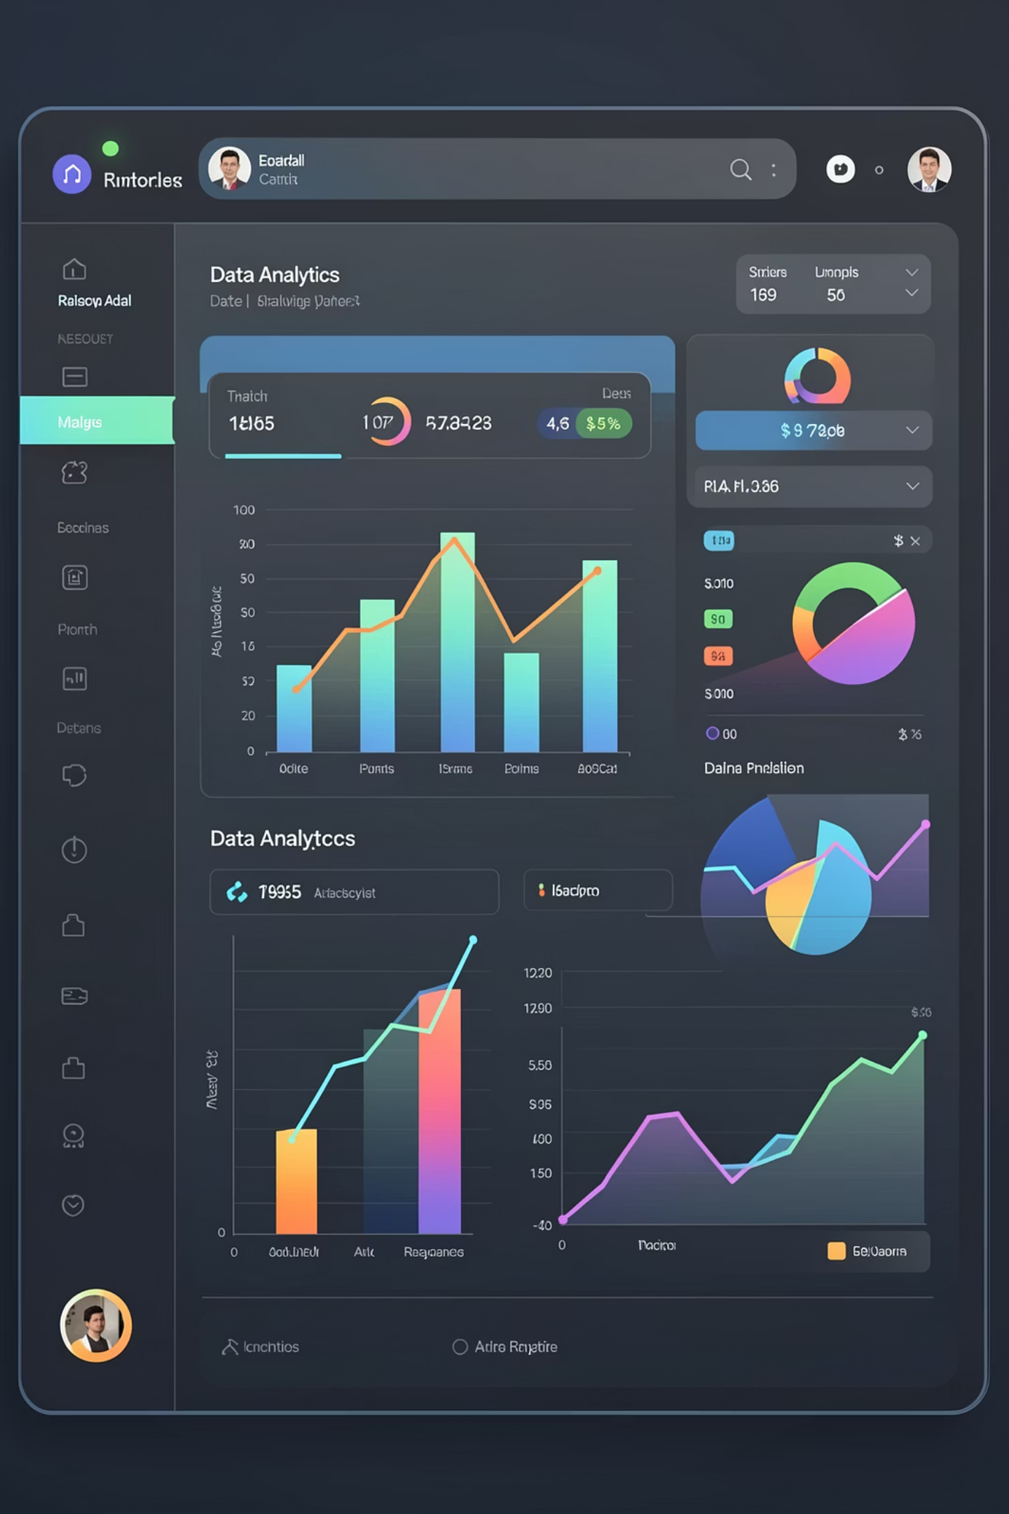




Data Overview
First step was understanding the data structure and quality.
Data Fields
Order ID, Date, Product/Color, Area/Governorate, Platform, Order Status, Delivery Time, Price
Key Questions
What does each column represent? Are there missing values? Is the data logical?

Slide 2
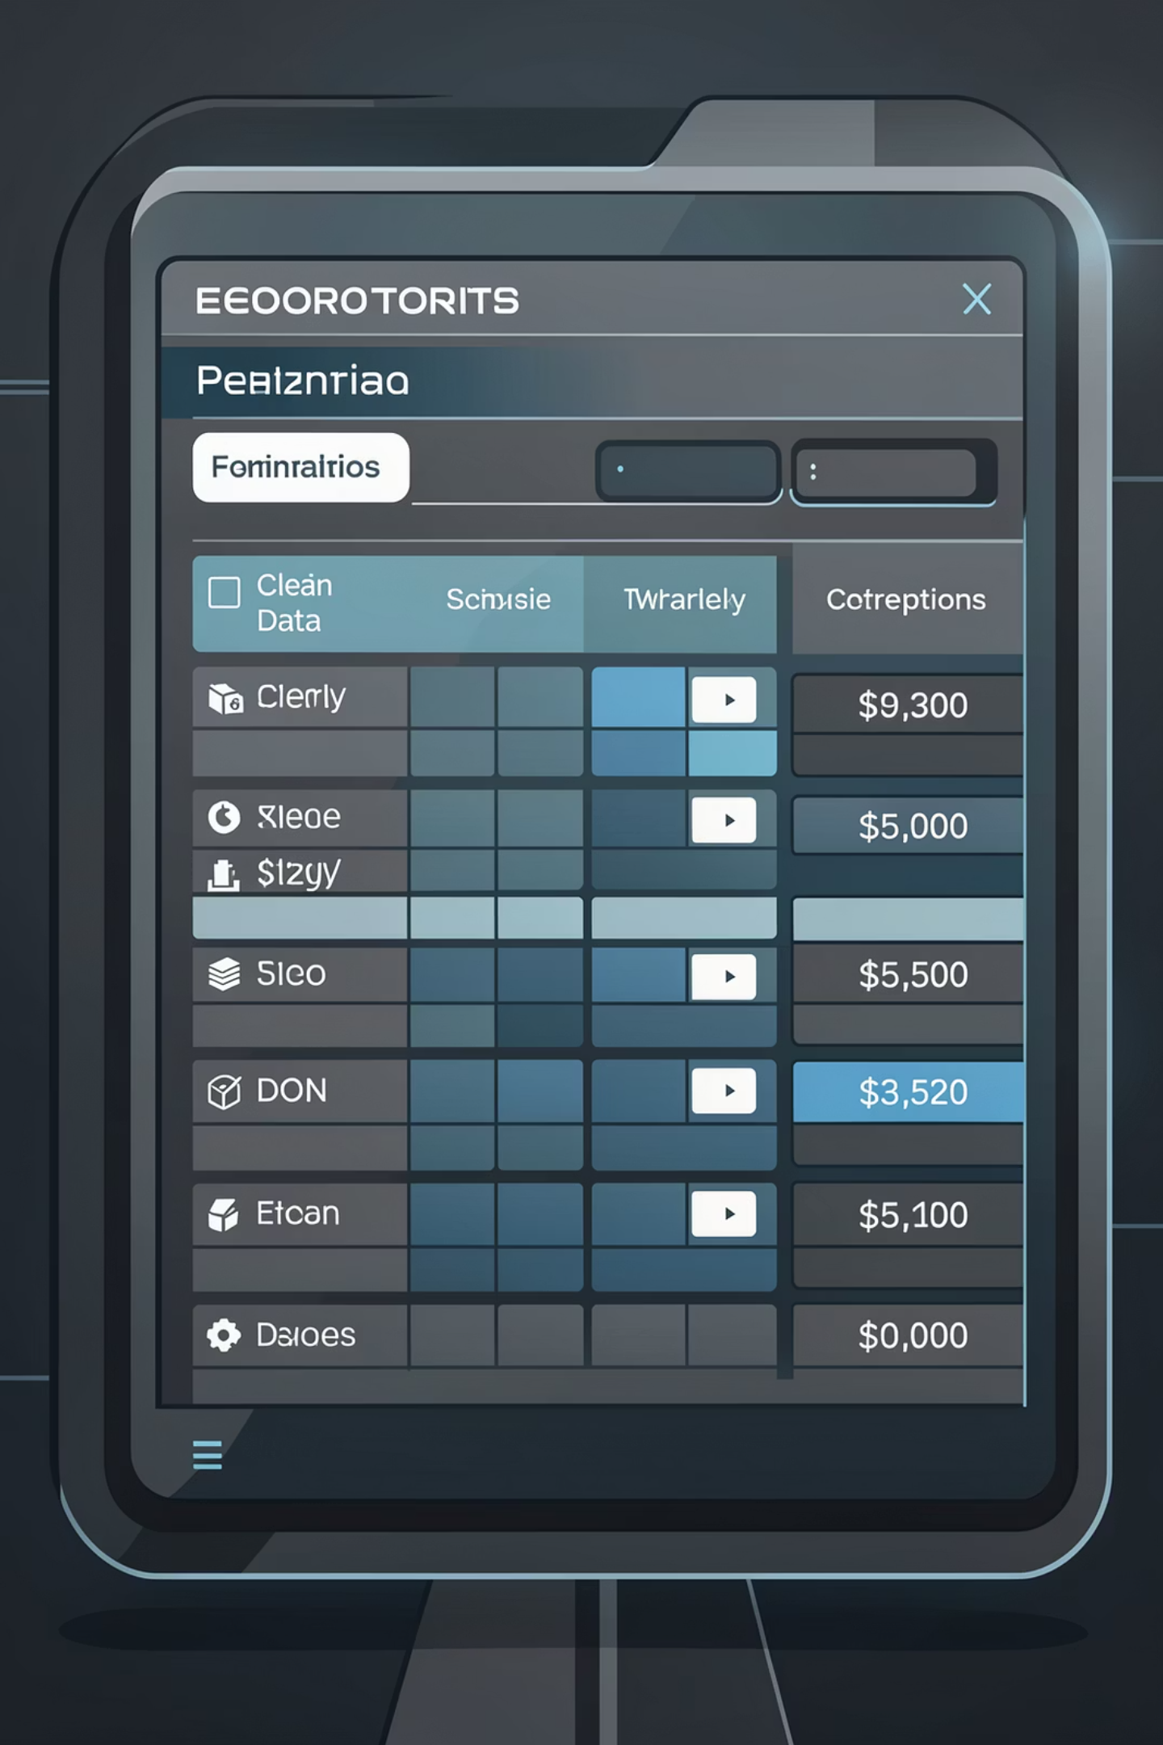
Data Cleaning Process
After understanding the structure, began the cleaning phase to ensure data quality.
01
Remove Duplicates
Eliminated repeated entries from the dataset
02
Handle Missing Values
Processed and addressed incomplete data points
03
Standardize Names
Unified governorate names, colors, and platform names
04
Validate Data Types
Ensured prices are numbers and dates use Date format

Slide 3

Data Transformation
Created Calculations
Computed Metrics
Organized by Categories
Calculated columns for analysis
Key performance indicators (KPIs)
Derived metrics from raw data
Total Sales across all orders
Total number of orders
Average price per order
Area/Governorate breakdown
Platform performance
Product and delivery status

Slide 4
Key Performance Indicators
1,076,738
51
10,353
Total Sales
Total Orders
Average Price
EGP in revenue
Completed transactions
EGP per order
Product & Color Analysis
Best Color
Best Seller
Black is the top-selling color
Bed has highest demand
Orders by Area
Cairo leads in order volume
Giza, Alexandria, and North Coast
Opportunity to improve delivery efficiency
Sales by Platform
Homesmart is the top sales platform
Focus on improving weaker platforms

Slide 5
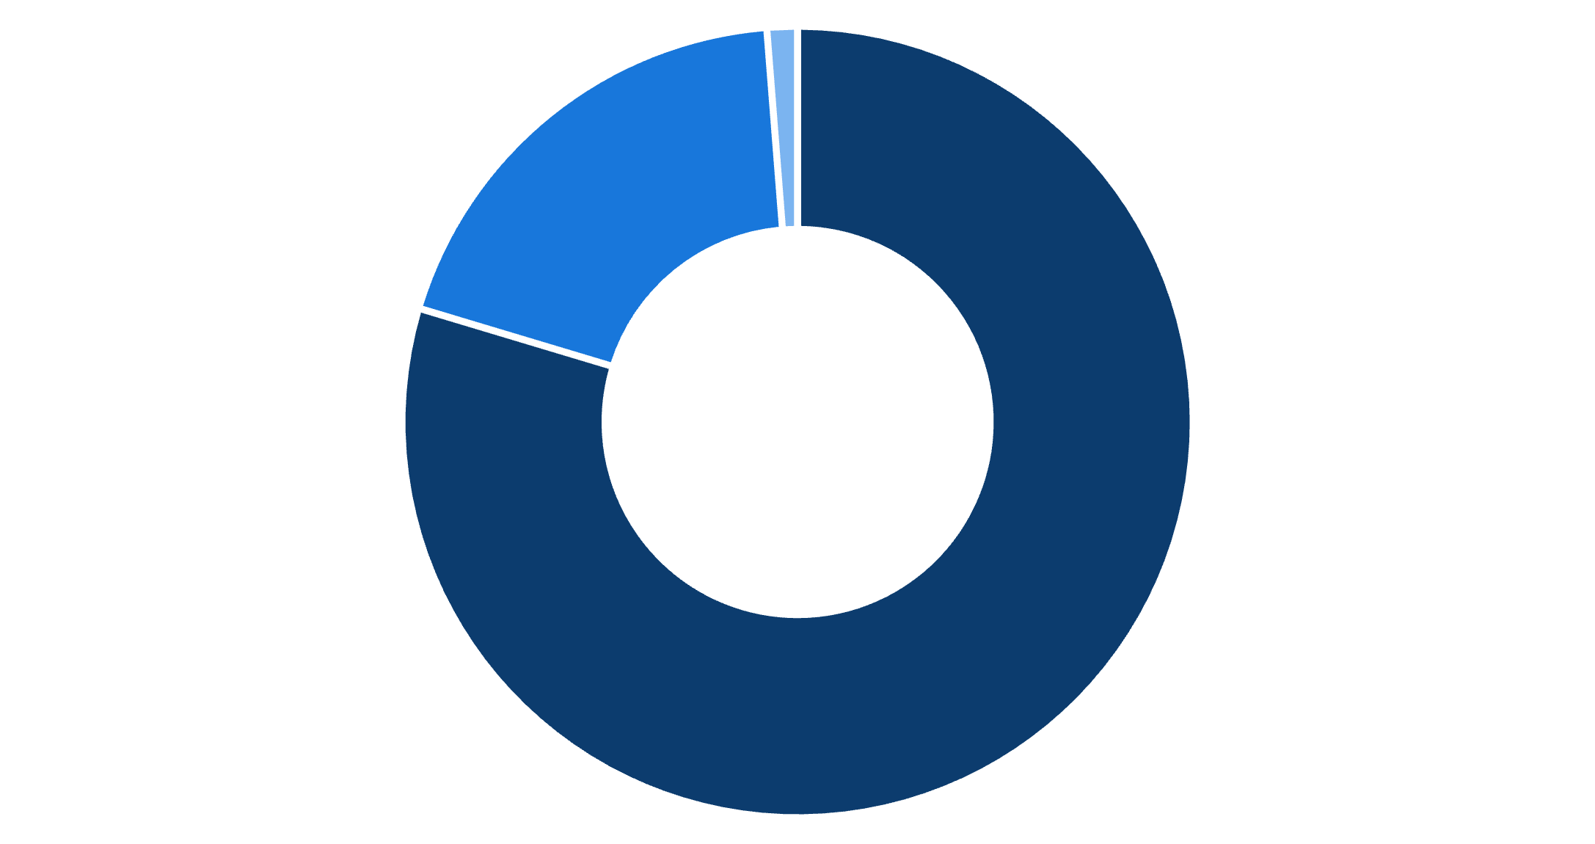

Delivery Performance
Delivery Status
On-Time Delivery
On Time
Late
Delivered
Rejected
Returned

Slide 6
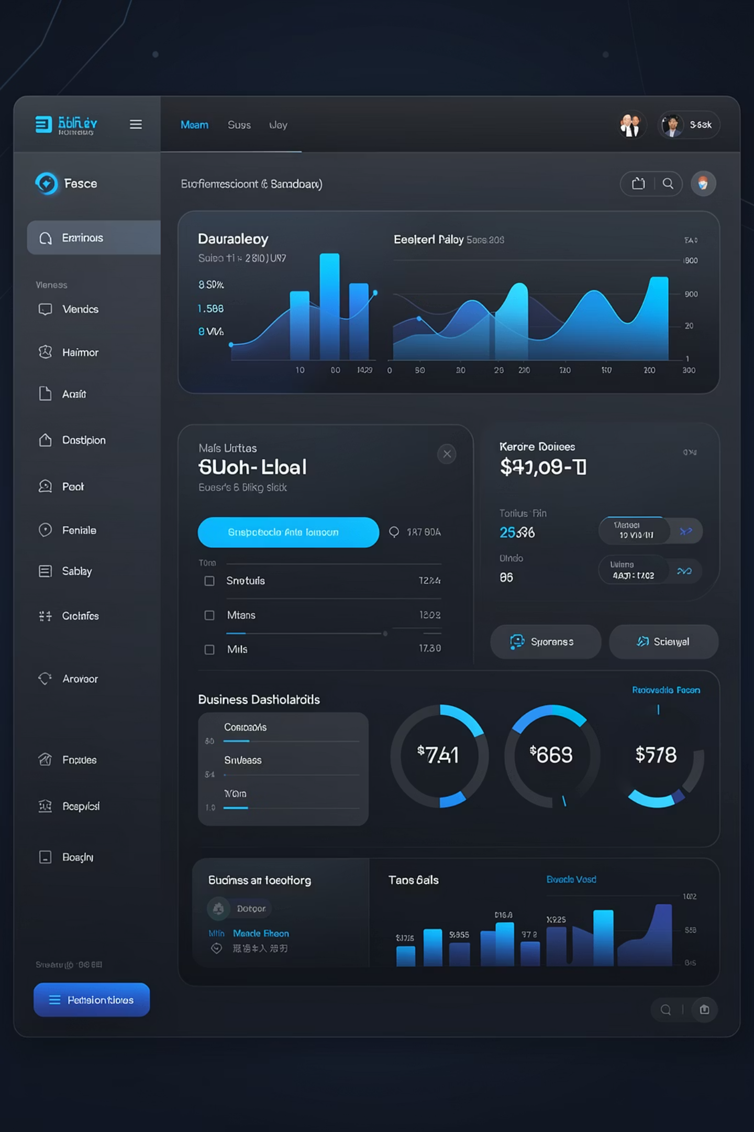




Dashboard Design Choices
Dark Theme
Used calm, professional colors for visual comfort and reduced eye strain
KPI Cards
Displayed key metrics in cards for quick executive visibility
Bar Charts
Used for comparative analysis across categories and dimensions
Pie Charts
Displayed proportions and percentage distributions effectively

Slide 7



Key Insights & Recommendations
Focus Areas
Top-selling products
Black color variants
Cairo market
Homesmart platform
Improvement Opportunities
Address rejection reasons (19%)
Reduce late deliveries (5%)
Boost weaker platforms

